Slide 1

SOFTWARE METRICS | FINAL REPORT
VELLORE INSTITUTE OF TECHNOLOGY
School of Computer Science and Information Systems
Fall Semester 2026–27 | Course: Software Metrics
DIGITAL FUGITIVE
AI-Driven Search Simulation & Software Metrics Analysis
TEAM MEMBERS
S. No. | Register Number | Name
1 | 23MIS0296 | Sooriya Moorthy
2 | 23MIS0527 | Deeksha M
3 | 23MIS0280 | Thiru Dev B
4 | 23MIS0521 | Priyadharshini S
128-run dataset • Grid-based AI search • Statistical analysis

Slide 2
PROBLEM STATEMENT
Problem Statement
Why does a grid-based search need reasoning?
THE CHALLENGE
THE NEED
THE EVALUATION
Hidden fugitives are distributed across a grid. Blind exploration can inspect unnecessary cells and increase movement.
A search agent needs to combine observations, neighbouring-cell information and radar feedback to select candidate cells.
Repeated runs are needed to measure search effort, execution time, fallback actions and run outcomes.
Project question: How can logical reasoning guide the search, and what do the run metrics reveal about its behaviour?
DIGITAL FUGITIVE | SOFTWARE METRICS
02

Slide 3
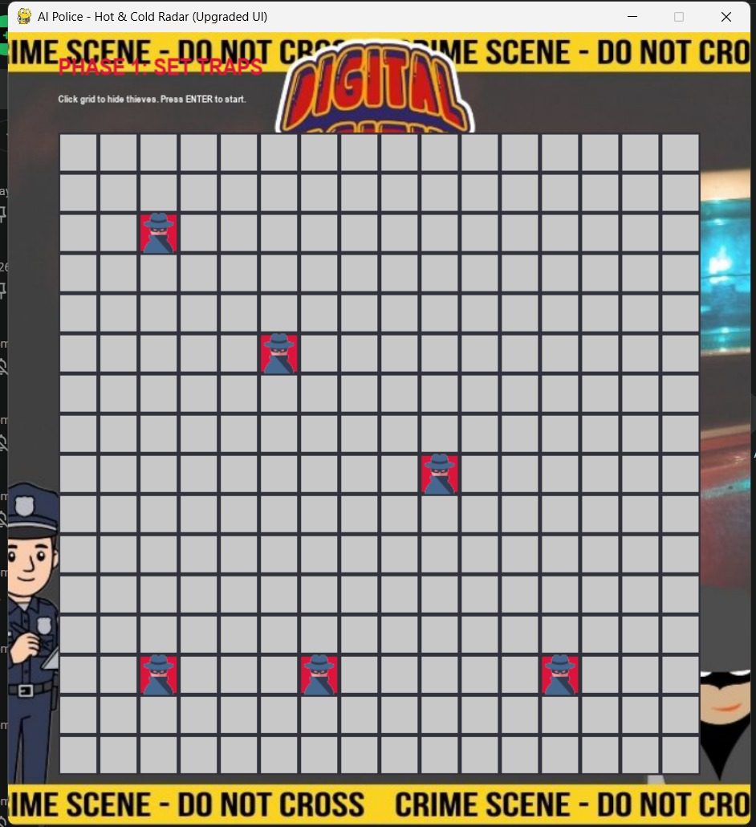
INTRODUCTION
Introduction
An interactive AI search simulation
Digital Fugitive is a Pygame-based simulation where hidden targets occupy cells in a 16 × 16 grid. Users configure the scenario and observe search progress through cell states and radar feedback.
Combines random exploration and knowledge-based reasoning
Uses grid neighbours and Manhattan-distance radar
Records 128 runs for software-metrics analysis
Example: Phase 1 — hidden-fugitive placement
DIGITAL FUGITIVE | SOFTWARE METRICS
03

Slide 4
SUMMARY
Project Summary
From visible search behaviour to measurable outcomes
AI SIMULATION
REASONING
METRICS
A grid-based environment with hidden fugitives, observations and radar feedback.
A knowledge base, propositional logic and constraint propagation guide candidate-cell selection.
128 runs analysed with distribution, control-chart, correlation and decision-tree methods.
Motivation: make search decisions understandable, compare run behaviour, and identify measurable patterns.
16 × 16 GRID
128 RUNS
DIGITAL FUGITIVE | SOFTWARE METRICS
04

Slide 5
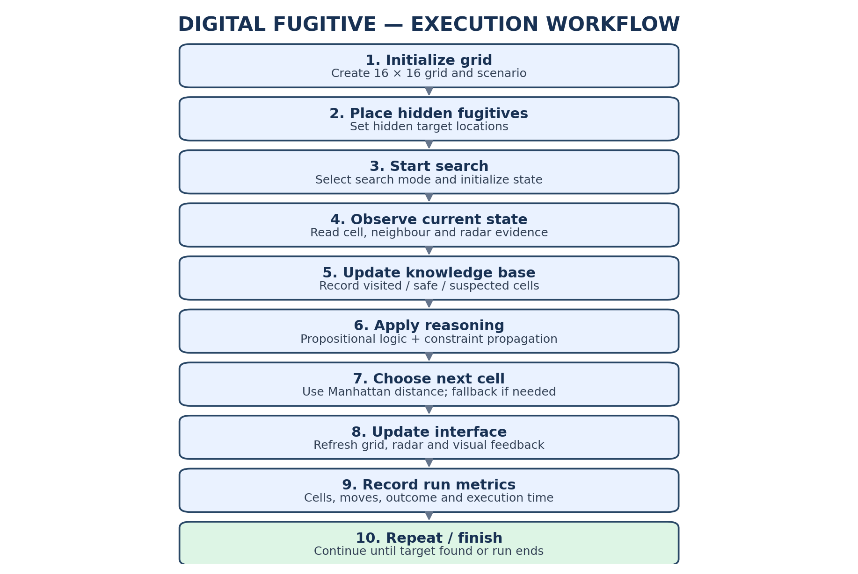
METHODOLOGY
Methodology
Search workflow and analysis pipeline
AI / SIMULATION METHODS
Randomized exploration and knowledge-based search
Propositional logic and constraint propagation
Neighbour information and Manhattan distance
Hot/Cold radar feedback and fallback moves
SOFTWARE-METRICS METHODS
Box plot and control chart
Pearson, Spearman and Kendall correlation
Decision-tree classification: Failure / No Failure
DIGITAL FUGITIVE | SOFTWARE METRICS
05

Slide 6
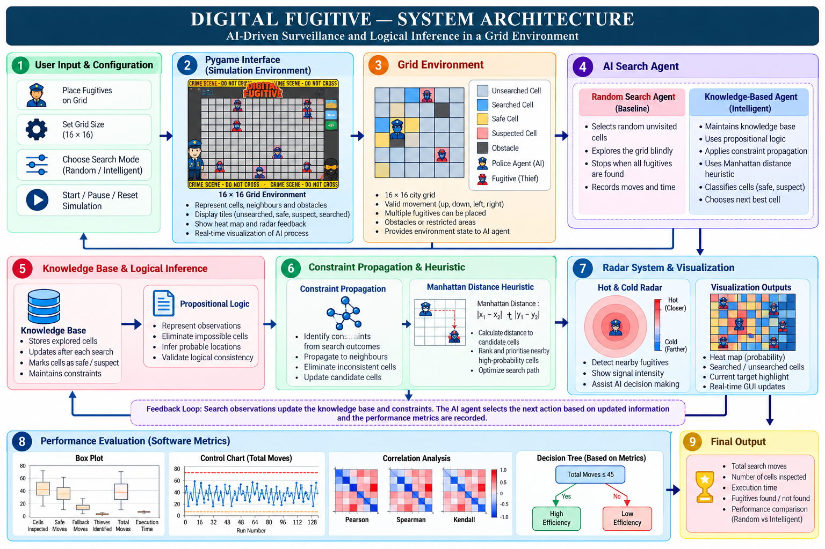
ARCHITECTURE
System Architecture
Layered view of the search and feedback system
Feedback loop: observations update the knowledge base; the next action changes the grid state.
DIGITAL FUGITIVE | SOFTWARE METRICS
06

Slide 7
PROPOSED SYSTEM
Proposed System
What the system does during a run
01
02
03
04
05
Initialize
Observe
Reason
Choose
Measure
Create the 16 × 16 grid and place hidden fugitives.
Read cell state, neighbour information and radar evidence.
Update knowledge and eliminate inconsistent candidates.
Select the next cell using logical evidence and distance feedback.
Record cells inspected, moves, outcome and execution time.
Fallback exploration is used when no guaranteed safe move is available.
DIGITAL FUGITIVE | SOFTWARE METRICS
07

Slide 8
DATASET
Dataset & Source Code
Use these links to access the dataset and implementation
DATASET (CSV)
GITHUB REPOSITORY
Digital Fugitive 128-Run Dataset with Execution Time
128 recorded simulation runs; metrics include cells inspected, safe moves, fallback moves, targets identified, total moves, failure and execution time.
Digital-Fugitive source-code repository
Contains the project implementation and supporting files.
Open dataset in Google Drive
Open GitHub repository
.
DIGITAL FUGITIVE | SOFTWARE METRICS
08

Slide 9
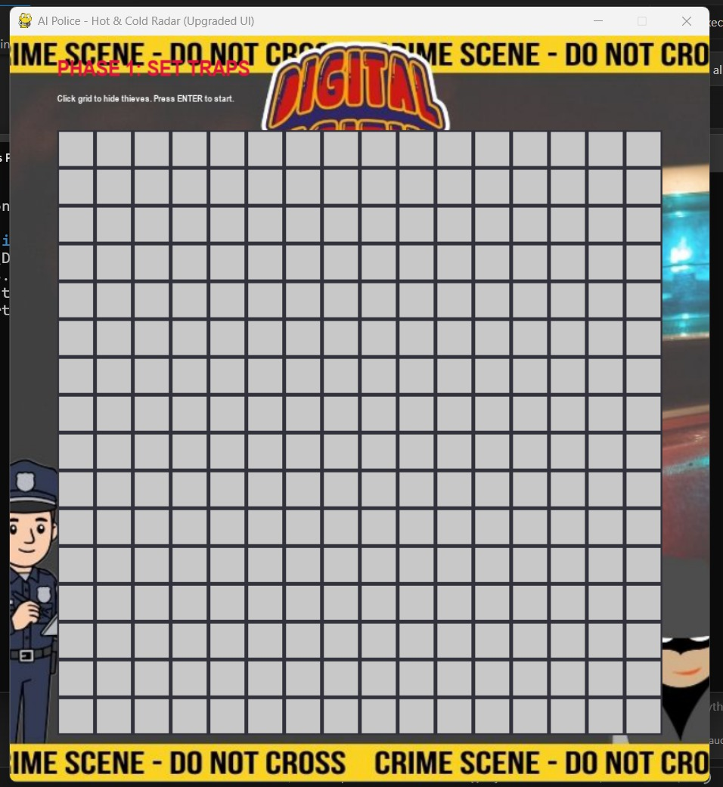
EXECUTION SCREENSHOTS
Project Outcomes — Interface & Setup
Screenshots supplied with the project
Initial grid before placing targets
Phase 1 — hidden-fugitive placement
DIGITAL FUGITIVE | SOFTWARE METRICS
09

Slide 10
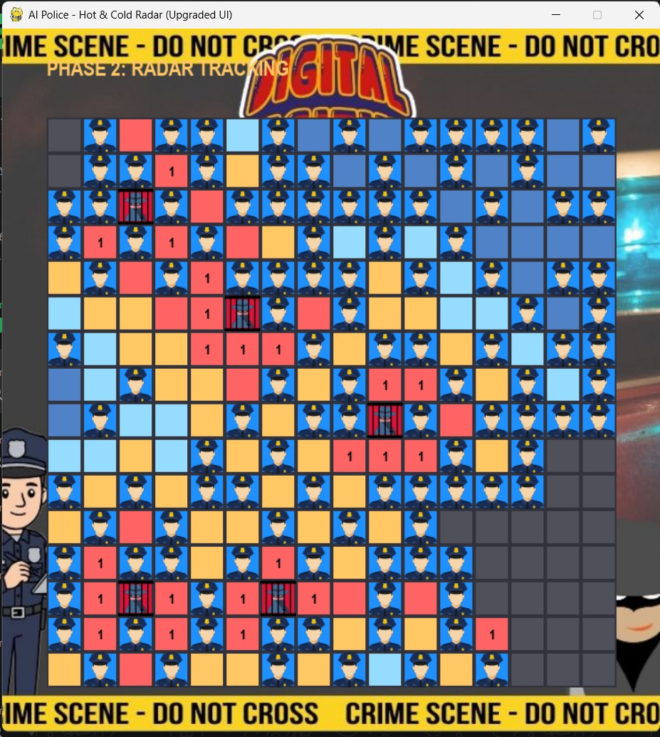
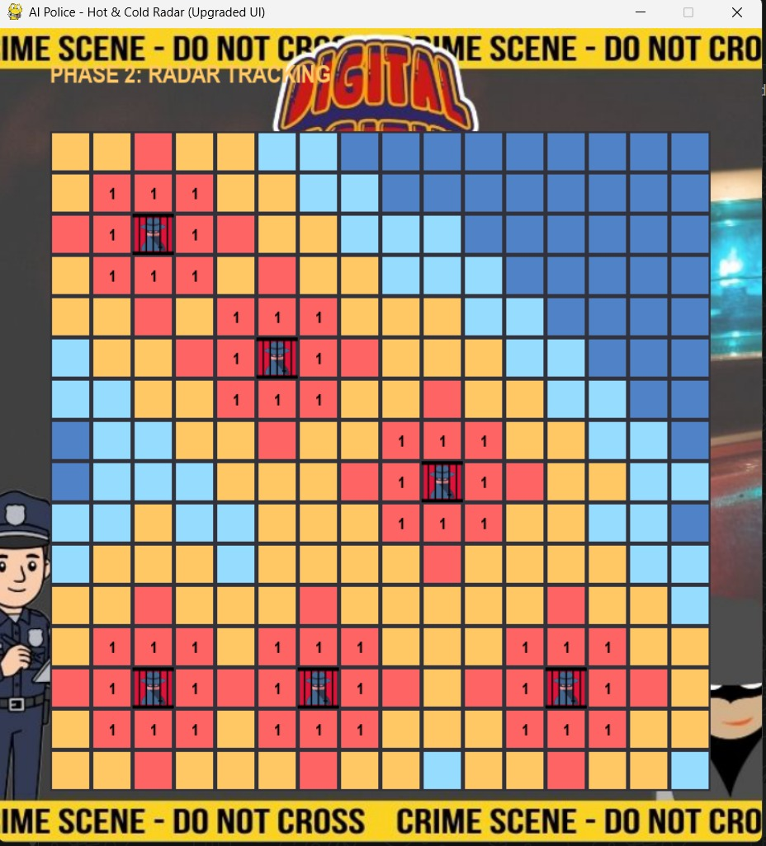
EXECUTION SCREENSHOTS
Project Outcomes — Radar Tracking
Cell colours and symbols visualize the search state
Phase 2 — radar tracking and cell feedback
Alternate tracking state from the supplied screenshots
DIGITAL FUGITIVE | SOFTWARE METRICS
10

Slide 11
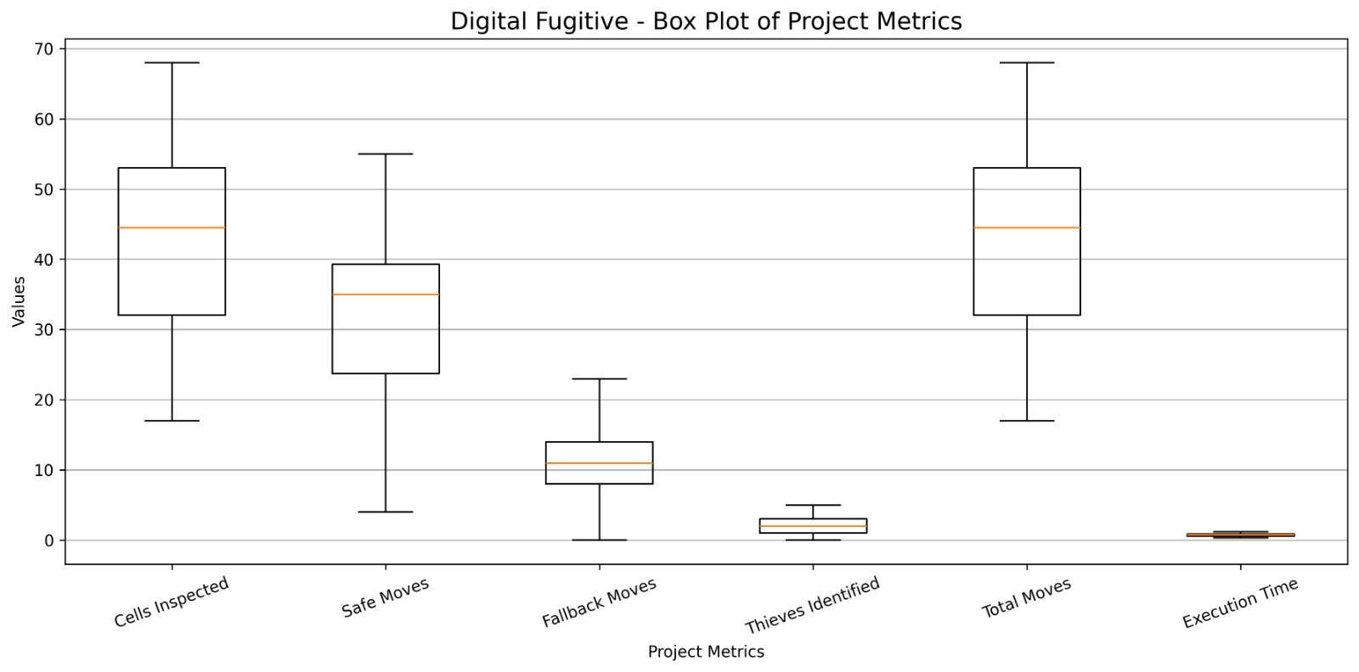
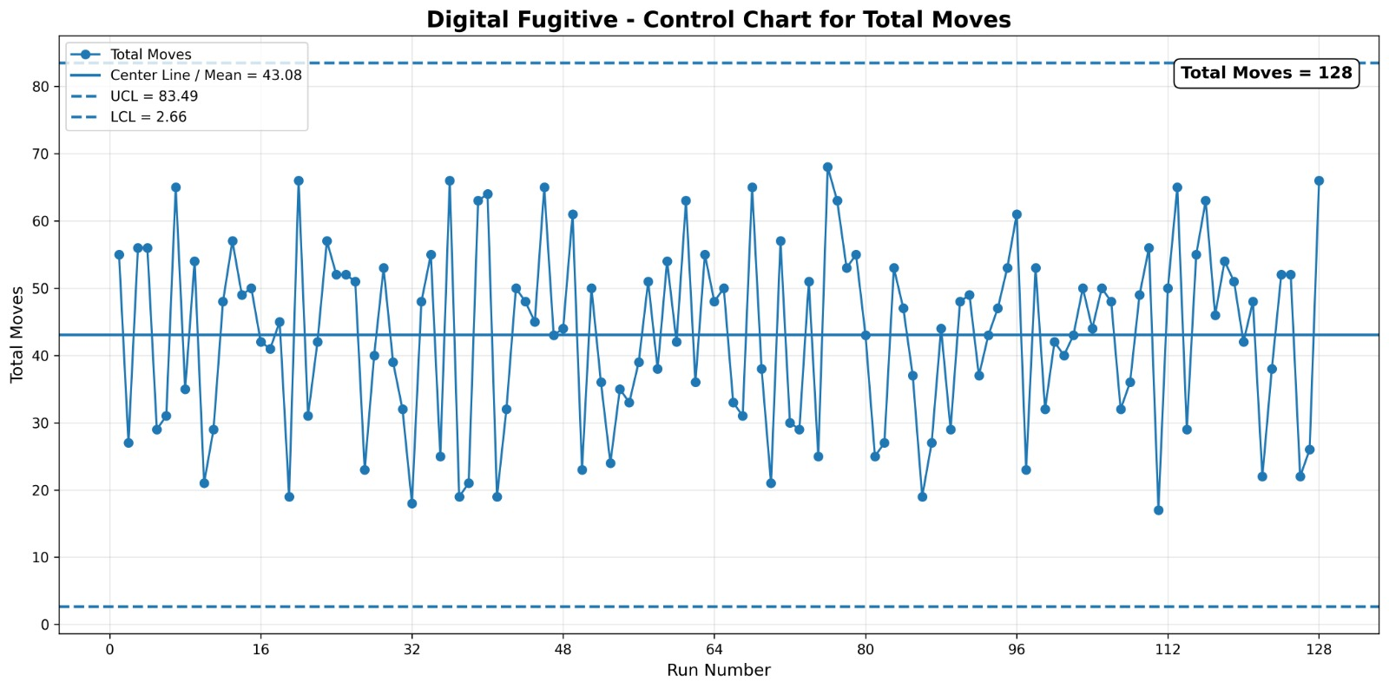
METRIC OUTCOMES
Software Metrics — Distribution & Stability
The figures below are reproduced from the supplied report
Box plot: spread and median of run metrics
Control chart: Total Moves across 128 runs
128 RUNS
43.08 MOVES
0.5–1.1 SEC
Dataset size used for analysis.
Reported mean for Total Moves.
Approximate execution-time range stated in report.
Reported control limits: UCL = 83.49 | LCL = 2.66
DIGITAL FUGITIVE | SOFTWARE METRICS
11

Slide 12
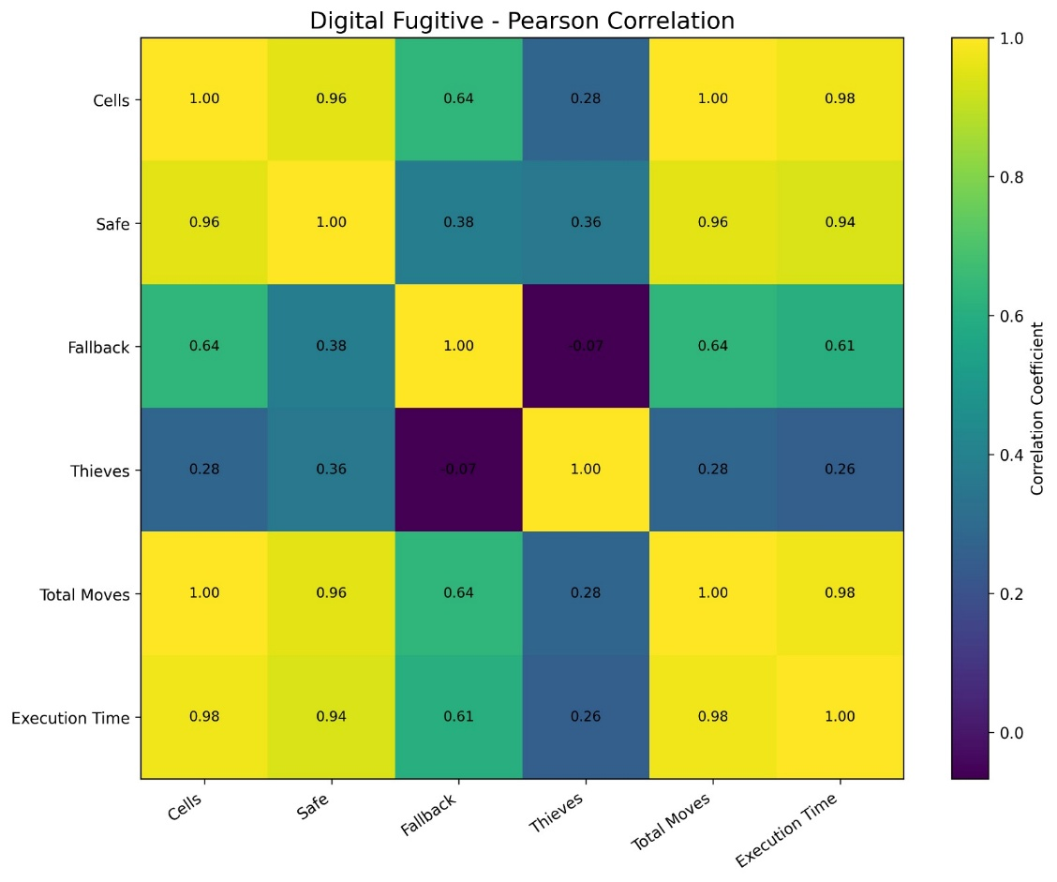
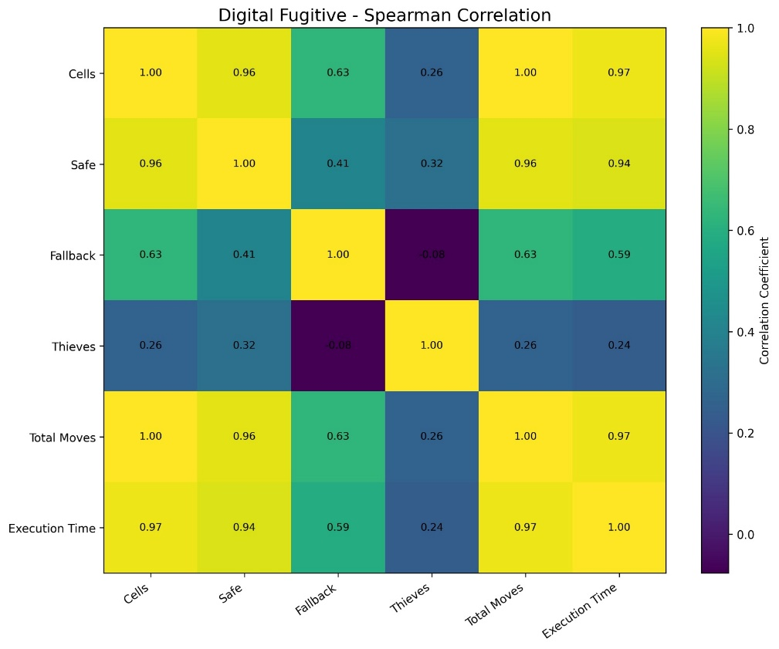
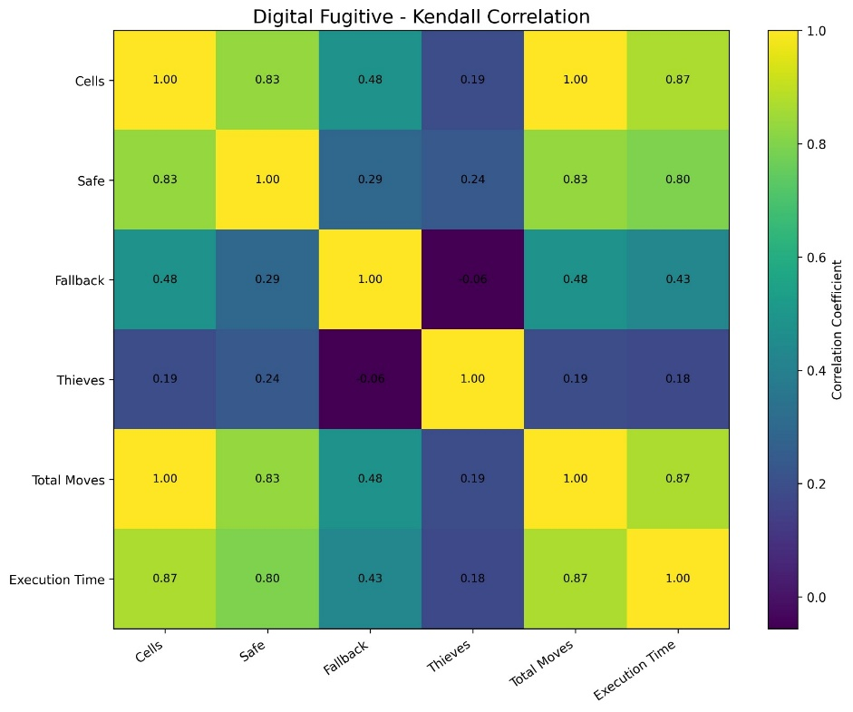
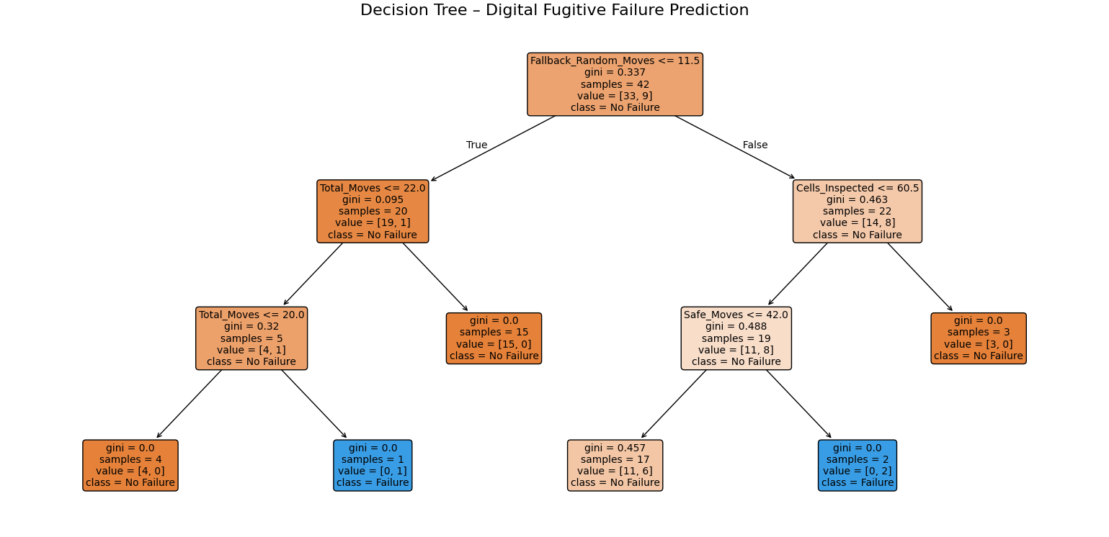
JUSTIFICATION
Justification — What Do the Metrics Tell Us?
Correlation and classification add evidence beyond screenshots
Pearson
Spearman
Kendall
Cells inspected ↔ total moves: reported correlation = 1.00
Cells inspected ↔ execution time: Pearson 0.98; Spearman 0.97
Decision tree classifies Failure / No Failure using run metrics
Correlation indicates association, not causation
Decision-tree classification outcome
DIGITAL FUGITIVE | SOFTWARE METRICS
12

Slide 13
CONCLUSION & FUTURE WORK
Conclusion & Future Enhancements
Key takeaways and practical next steps
CONCLUSION
FUTURE ENHANCEMENTS
• Digital Fugitive makes search behaviour visible through a grid and radar feedback.
• 128 runs provide a basis for analysing movement, inspected cells and execution time.
• Reported metrics show a strong relationship between cells inspected and total moves.
• The control chart and decision tree provide complementary views of stability and outcome.
• Benchmark random and knowledge-based search on identical scenarios.
• Add more runs and report confidence intervals.
• Evaluate the classifier using precision, recall, F1-score and cross-validation.
• Add reproducible seeds, automated CSV export and a results dashboard.
DIGITAL FUGITIVE | SOFTWARE METRICS
13

Slide 14
DISCUSSION
Questions — Software Metrics
Possible questions for the presentation discussion
1. Why were 128 runs used for the analysis?
2. What does the box plot tell us about variation in Total Moves?
3. What do UCL and LCL mean in the control chart?
4. How are Pearson, Spearman and Kendall correlation different?
5. Why does correlation not prove causation?
6. What does the decision tree predict, and which metrics does it use?
Discussion prompt: Which metric is most useful for explaining search efficiency, and why?
DIGITAL FUGITIVE | SOFTWARE METRICS
14

Slide 15
THANK YOU
Questions & Discussion
DIGITAL FUGITIVE
AI-Driven Search Simulation & Software Metrics Analysis
Vellore Institute of Technology | Fall Semester 2026–27

